Slide 1
How to make your thesis, dissertation,
or scientific paper transparent and reproducible
Florio Arguillas, Ph.D.
Daniel Alexander
CISER

Slide 2
Cornell Institute for Social and Economic Research
CISER was founded in 1981 to support the evolving computational and data needs of social scientists and economists throughout the entire research lifecycle
The CISER Data Archive provides access to approximately 27,000 social and economic dataset files
CISER staff offers appraisal, curation, and replication services to researchers preparing for manuscript submission to scholarly journals

Slide 3
Goals of workshop
Walk through the steps of creating a Reproduction Materials package
What to include in your RM
File, documentation, data, code, output quality reviews
Importance of Independently Understandable Materials
Only need to run the command file(s) to get identical results
Make it easily findable/discoverable and accessible

Slide 4
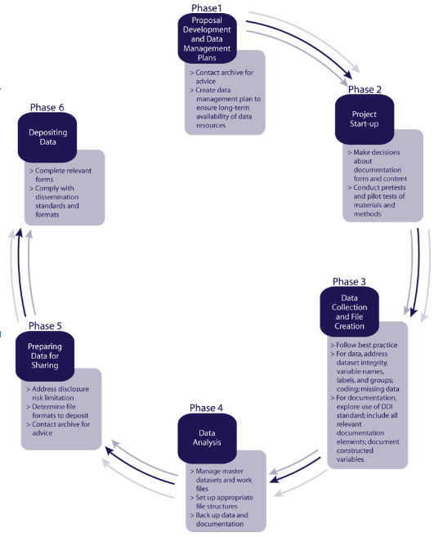
Changing Mindset of Purpose of Researching
What is your end-goal when writing a thesis, dissertation, or scientific paper?
Plan ahead for sharing and archiving of supplementary materials for your scientific paper for discovery, access, and reuse
Source: https://www.icpsr.umich.edu/icpsrweb/content/deposit/guide/index.html

Slide 5
Outline
What is Transparency? Reproducibility?
Why make research transparent and reproducible
R Squared and other tools
Hands on
Quality Review Framework
Code
Q and A
WHY
HOW

Slide 6
Transparency
Definition:
to make the process of research – including data collection, coding, and analysis – clearly visible to all readers
provides readers full access to the data, methodology (including coding and analysis scripts), and, whenever possible, tools used in data analysis
The end goal is to make research as open, understandable, and clearly replicable as possible
~
=
</>
https://ejournals.bc.edu/ojs/index.php/jtla/pages/view/transparency

Slide 7

Pre-Registration
https://cos.io/prereg/
“When you preregister your research, you're simply committing to your plan in advance, before you gather data. Preregistration separates hypothesis-generating (exploratory) from hypothesis-testing (confirmatory) research. Both are important, but the same data cannot be used to generate and test a hypothesis, which can happen unintentionally and reduce the clarity and quality of your results. Removing these potential conflicts through planning improves the quality and transparency of your research, helping others who may wish to build on it.”
http://help.osf.io/m/registrations/l/524205-register-your-project

Slide 8
Citation Transparency
Making sure that everything cited is in your references, cite the specific pages used if possible especially in thesis dissertation. For articles it could be supplementary material.

Slide 9
Reproducibility (Computational Reproducibility)
Definition:
Changes in scientific practice and reporting standards to accommodate the use of computational technology…in particular whether the same results can be obtained from the data and code used in the original study.
</>
Stodden, V. (2015). Reproducing statistical results. Annual Review of Statistics and Its Application, 2(1), 1–19. https://doi.org/10.1146/annurev-statistics-010814-020127

Slide 10
Independently Understandable RM
Guarantees that the reproduction materials contain sufficient information for researchers to reproduce the results exactly.
Decreases (or eliminates) the possibility of being contacted for questions about your reproduction materials

Slide 11
Why prepare? For You
Good Practice:
Ability to document your own code (Vilhuber, 2017)
For yourself in [t+n]
For others on the team
For human kind
Robustness to errors
Discovery of error in an early step at a late stage of the research is easier to fix (Vilhuber, 2017)
Early archiving may enable a researcher to enhance the impact (and certainly the visibility) of a project
Studies with links to code and data gets cited more (Piwowar et., al, 2007)
Sources: Vilhuber, Lars (2017) https://www.vrdc.cornell.edu/info747x/wp-content/uploads/2017/11/INFO7470-2017-S11-Replication-in-RDC.pdf
https://www.icpsr.umich.edu/icpsrweb/content/deposit/guide/index.html

Slide 12
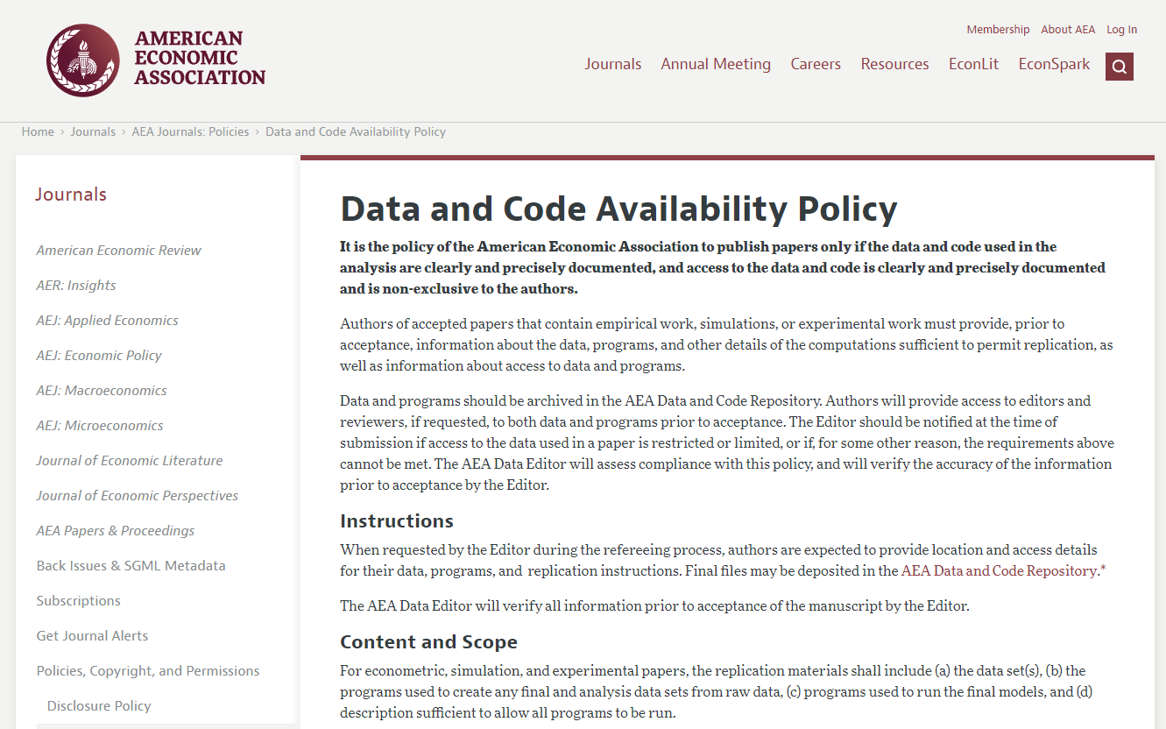
Why prepare? For You
Sources: https://www.aeaweb.org/journals/policies/data-code/

Slide 13
Why prepare? For better science
When reproduction materials are available:
Allows scientists to test and replicate each others’ findings
Reinforces open scientific inquiry. The self-correcting features of science work most effectively.
Encourages diversity of analysis and opinions. Researchers having access to the same materials can challenge each other’s analyses and conclusions.
Promotes new research and allows for the testing of new or alternative methods.
Improves methods of data collection and measurement through the scrutiny of others by allowing the scientific community to reach consensus on methods.
Reduces costs by avoiding duplicate data collection efforts.
Provides an important resource for training in research. Secondary data are extremely valuable to students, who then have access to high-quality data as a model for their own work.
Source: https://www.icpsr.umich.edu/icpsrweb/content/deposit/guide/index.html

Slide 14
Reproduction of Results Service (R Squared)

Slide 15
Specifics of CISER R SQUARED
Do
Don’t Do
Ensure:
Transparency and Reproducibility
Ease of access to data and code
Independently Understandable
Reproduce Output
Archival packaging
Suggestions for glaring code inefficiencies
Data + code = results
Methodology Check
Share anything before article is published
Challenge or check the client’s conclusions or theories
Change client’s code or paper

Slide 16
Reasons for the service
We want researchers to have publication-ready reproduction materials prior to publishing their manuscripts.
To provide researchers confidence that their reproduction materials will produce results identical to the computational results written in their manuscripts.
To encourage researchers to share their code and data
To relieve researchers of stress when someone requests for a copy of their reproduction materials in the future. They can PROMPTLY respond by handing them a copy of their reproduction materials or by pointing to a trusted digital repository hosting these materials.

Slide 17
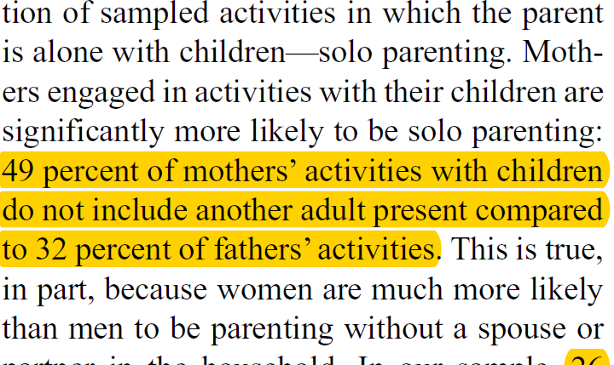
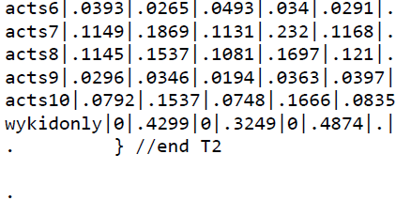
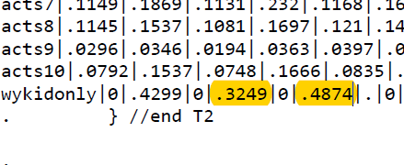
Article
Highlight all sections (e.g., paragraphs, sentences, tables, charts) that reference output derived from your data.

Slide 18
Command file
***********************************************************
***********************CODE TITLE**************************
***********************************************************
clear
log using “..\demoCodeLog.smcl", replace text
import delimited "<path>\HelloWorld.txt"
//Labeling the variables and values
label variable treatment "The manipulation group"
label define treatment1 1 “Well Documented" 2 “Poorly Documented"
label value treatment treatment1
label variable pieces “Good labels are descriptive but not too long"
label variable gender "Gender"
label define gender1 1 "Male" 2 "Female“
******** Table 1 - Descriptive statistics of the sample
tab mmff
ttest age if mmff ==1 | mmff == 2, by(mmff) unequal
ttest age if mmff ==3 | mmff == 4, by(mmff) unequal
Label all variables and values
Comment code to describe processes and map to paper sections
Order code outputs in the same order as they appear in paper
Think about variable names

Slide 19
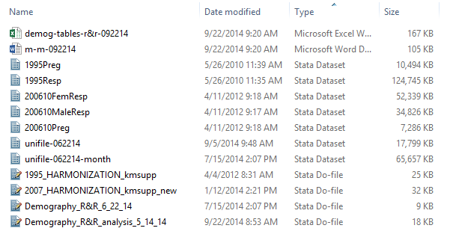
code
Specify the sequence of execution if it consists of multiple files. Prefix the filename with Step #.
Add comments that map sections of code to results in the manuscript. Make sure commands that generate results are preceded by comments that indicate which result the command generates. For example:
*The following command generates column 1 of Table 1
*The following command generates the mean age mentioned on page 3, paragraph 3

Slide 20
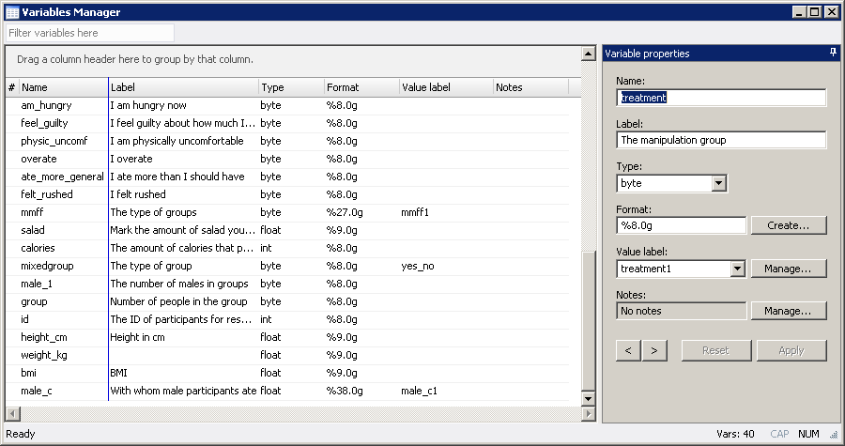
DATA
All variables and values labeled
Free of errors and inconsistencies
Data anonymized? Depends!

Slide 21
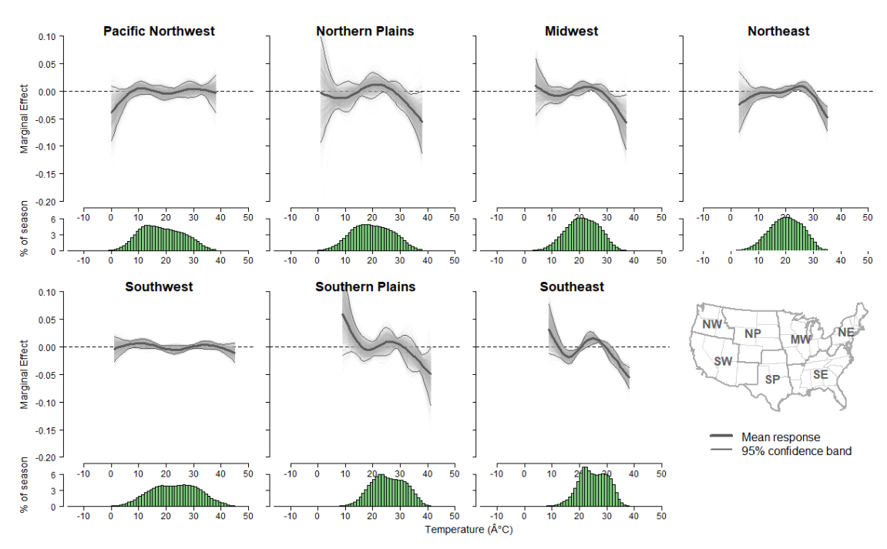
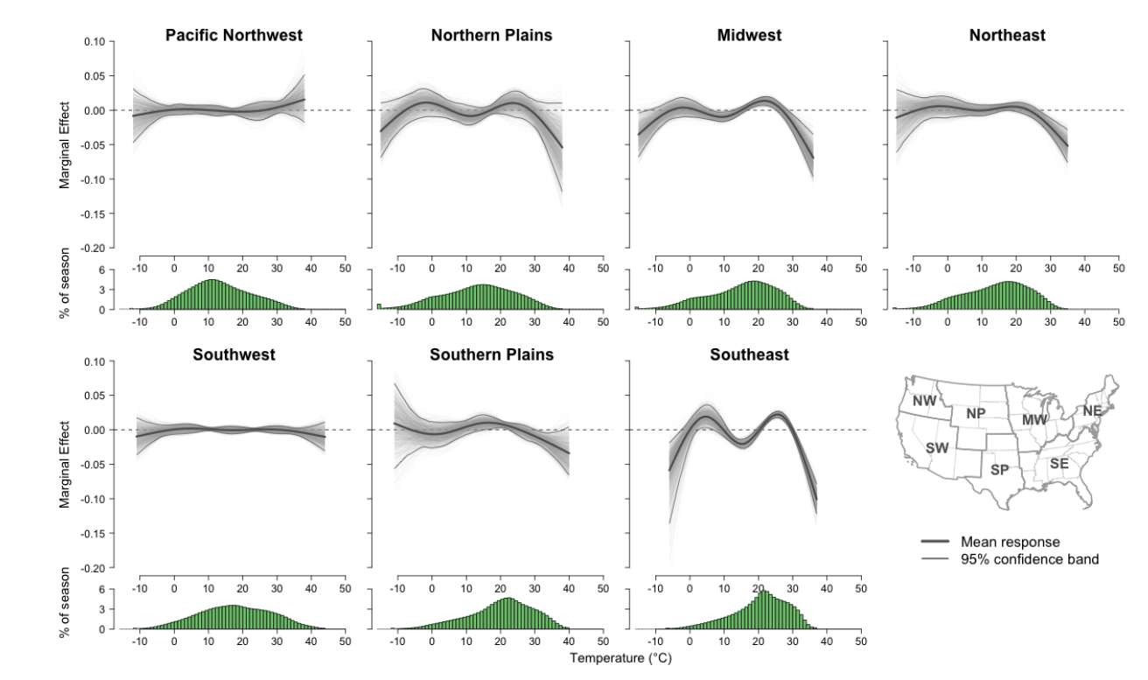
Lack of Seed
Any random generation requires a seed or else it can have different results and will not be reproduced.
Example on the top is without the seed and bottom is with it.

Slide 22
All-In-One Service for Reproduction
5
Post
4
Proof
3
R&R
Submit
2
Identify and apply quality improvement interventions
R-Squared
Publication
Check Submission: Complete?
Run Code:
Error-free?
Compare Results:
Identical?
Journal/
ProQuest
Receive Submission
1
Assemble Package
Yes
Archival Storage & Access
Client Deposits
Yes
Yes
Versioning
Journal-specified Repository
No
No
No
Optional:
(prep catalog, mint DOI)
Discuss with client and make necessary corrections
CISER Data Archive
E-Commons

Slide 23
Examples of good reproduction packages
Kim
https://doi.org/10.6077/80ph-y162
Ortiz-Bobea:
https://doi.org/10.6077/f26v-xz15

Slide 24

Most Common Error Types present in Manuscripts
Rounding
Typos
Misidentification
Out of-Date Tables
Missing from Package
Incorrectly Marking p-values

Slide 25
Rounding
Extremely common and easy to miss
Different software/people round in different ways, compounding if it is an error or difference of style
However inconsistent rounding is always a problem
Double rounding can cause errors as well

Slide 26
Typos
Sometimes obvious, such as missing a decimal place when all the others have it
Can also just be a mistyped number or two

Slide 27
Misidentification
(looking at wrong cell in output file)
Very easy when there aren’t output management software/practices
Difficult to detect from repeated checks, as the number is present on the output page, but simply is not the result that should be included

Slide 28
Out of Date Tables
Descriptive Tables are most common culprit
Researchers will generate their descriptive tables and then further clean data
Can be calculated inconsistently as well, such as valid vs total percentage
Plenty of other tables can have this happen as well, as researchers often don’t re-run their entire code (especially for long execute times)

Slide 29
Missing From Package of Scripts
Can be similar to “hard coded variables” in that the calculation just done by hand/excel and put into the manuscript
Very common with regards to figures as they are often edited or done in non or different statistical package programs (such as excel) and then edited to look better

Slide 30
Incorrectly Marking P-Values
Often happens with regards to rounding
0.045 rounds to 0.05 but should be marked as ≤ 0.05, but can mistakenly be marked as =0.05
0.101 shouldn’t be marked as ≤0.10, as it is >0.10
Can come from inconsistency of having multiple people doing the tables
Easy to make one of the other errors

Slide 31
Most Common Error Types present in Scripts
Not calling the data initially
Hard Coded Variables
Missing Files/Commands
No (or poor) Commenting
Uncertain Order of Execution
Does not follow the order of the Output
Prerequisites
Extraneous output/lines of code

Slide 32
Not calling the data initially
Many clients simply open the data with the GUI instead of via code
Can cause confusion when there are multiple data files present (including raw data, cleaned data, intermediate data, data from different sources, etc.)

Slide 33
Hard Coded Variables
Generally done either by hand calculator or Excel and results entered into program file
Can cause errors when data is further refined or if mistake was made when calculating it
Causes confusion as to where the number came from and what it represents

Slide 34
Missing Files/Commands
Impossible to fully reproduce results with needed files/commands missing
Often because researchers will work on multiple computers or utilize poor version control and delete things
Can also be caused by hard coding a variable and then discarding the code or by using the GUI and not pasting the commands

Slide 35
Poor or No Commenting and Poor Variable Names
People will write the code for themselves, and thus commenting can tend to fall by the wayside instead of commenting as they go
What makes sense to someone who has worked with the code/data for four years may not make sense to someone else and may need further explanation

Slide 36
Uncertain or No Order Specified in Title of Scripts
Researcher knows the steps in running the program files so doesn’t order them
Alternatively, they know the step, yet use confusing names such as “first-first…” vs “actually-first…” vs “initialize…”
Should have numerical component e.g. Step1... Or 1_1-cleaning…
If not run on a 'clean install' then can have previously generated results affect outcomes

Slide 37
Doesn’t Follow the Order of the Manuscript
Things are rarely coded in the exact order they appear in the manuscript and can be impossible to do so. However, having the results generally follow the manuscript will dramatically increase transparency
Often calculated on other computers and then the code thrown together to put everything in the same script file

Slide 38
Prerequisites (ado, library, extension, etc.)
The idea of reproducibility is it will work on any computer and without the list of prerequisites, that will not work
Very easy to forget as they don’t need to be reinstalled from project to project
Prone to breaking things when they, or the base software gets updated, so having unneeded ones can be problematic

Slide 39
Extraneous outputs/lines of code
Makes the code and output files longer and unnecessarily confusing
Not very transparent to have outputs that are not used/needed
Can cause mis-identification or other issues detailed in the common errors in manuscript.
Time consuming on both the re-user and checker’s.

Slide 40
Hands-on: Data & code review
Distribute the handouts and introduce/begin first exercise

Slide 41
Quality Review for Curation
FILE
REVIEW
DATA
REVIEW
CODE
REVIEW
DOC
REVIEW
OUTPUT REVIEW

Slide 42
curating for reproducibility FILE QUALITY REVIEW
FILE
REVIEW
Check for presence of all files
Verify content of files matches expected format
Assign persistent identifier
Create study citation and study-level metadata record
Record file size details
Create non-proprietary versions of files
Implement migration strategy for file formats

Slide 43
Hands-on: Data and Code Review
Hands on with File Review
Look through the files and compare it to the manifest
The next slide contains the necessary files, not the complete list. The program will run as long as you have those

Slide 44
Replication_Documentation_for_Midlife_Crisis_Paper
Analysis-Data
Command-Files
1-import-wdi.do
2-import-pew.do
3-processing.do
4-data-appendix.do
5-analysis.do
Documents
Original-Data
importable-pew.dta
original-wdi.xlsx
z-Metadata

Slide 45
curating for reproducibility DATA QUALITY REVIEW
DATA
REVIEW
Restricted Access Data
Provide detailed instructions on how to gain access to the data in a readme file or data documentation.
Public-use Data
Provide detailed instructions on how to gain access to the data in a readme file or data documentation.
Make the re-user download the data and execute your code against it.
But, also provide the original data in case it can no longer be found online

Slide 46
curating for reproducibility DATA QUALITY REVIEW
DATA
REVIEW
Check for undocumented variable and value information
Examine data for inconsistencies and errors
Discrepancies in number of observations
Out-of-range or wild codes
Undefined null values
Review data for confidentiality issues
Add question text to variables
Identify and address foreign language characters
Adjust format widths
Optimize file size
Standardize missing values
Check for consistency and skip patterns
Source: https://www.icpsr.umich.edu/icpsrweb/content/deposit/guide/index.html

Slide 47
curating for reproducibility DATA QUALITY REVIEW – Variables
DATA
REVIEW
The exact question wording or the exact meaning of the datum
The text of the question integrated into the variable text
Universe information, i.e., who was actually asked the question
Exact meaning of codes
Missing data codes
Unweighted frequency distribution or summary statistics
Imputation and editing information
Details on constructed and weight variables.
Location in the data file
Variable groupings
Source: https://www.icpsr.umich.edu/icpsrweb/content/deposit/guide/index.html

Slide 48
Data readme
Create one readme file for each data file, whenever possible. It is also appropriate to describe a "dataset" that has multiple, related, identically formatted files, or files that are logically grouped together for use (e.g. a collection of Matlab scripts). When appropriate, also describe the file structure that holds the related data files.
Name the readme so that it is easily associated with the data file(s) it describes.
Write your readme document as a plain text file, avoiding proprietary formats such as MS Word whenever possible. Format the readme document so it is easy to understand (e.g. separate important pieces of information with blank lines, rather than having all the information in one long paragraph).
Format multiple readme files identically. Present the information in the same order, using the same terminology.
Use standardized date formats. Suggested format: W3C/ISO 8601 date standard, which specifies the international standard notation of YYYY-MM-DD or YYYY-MM-DDThh:mm:ss.
Follow the scientific conventions for your discipline for taxonomic, geospatial and geologic names and keywords.

Slide 49
curating for reproducibility DOCUMENTATION QUALITY REVIEW
Title of data collection
Principal investigators
Description or abstract
Sponsor or funding agency
Type of Data (Quanti, Geo, Quali, Mixed)
Methodology
Universe
Units of analysis (Individual, Household, Metropolitan area, other)
Mode of data collection
Type of data collection (admin, census, clinical, observational data, etc)
Study time period
Data collection dates
DOC
REVIEW
Geographic coverage areas
Geographic unit
Sampling information
Response Rate
Measurement tools/Scales
Weights
Keywords
Data-Related publications
Confidential and/or copyrighted
Grant managers
Original data source citation
Analysis software version

Slide 50
curating for reproducibility DOCUMENTATION REVIEW – METADATA
DOC
REVIEW
Related publications. Citations to publications based on the data, by the principal investigators or others.
Technical information on files. Information on file formats, file linking, and similar information.
Data collection instruments. Copies of the original data collection forms and instruments. Other researchers often want to know the context in which a particular question was asked, and it is helpful to see the survey instrument as a whole. Copyrighted survey questions should be acknowledged with a citation so that users may access and give credit to the original survey and its author.
Flowchart of the data collection instrument. A graphical guide to the data, showing which respondents were asked which questions and how various items link to each other. This is particularly useful for complex questionnaires or when no hardcopy questionnaire is available.
Index or table of contents. A list of variables either in alphabetic order or organized into variable groups with corresponding page numbers or links to the variables in the technical documentation or codebook.
List of abbreviations and other conventions. Variable names and variable labels often contain abbreviations. Ideally, these should be standardized and described.
Interviewer guide. Details on how interviews were administered, including probes, interviewer specifications, use of visual aids such as hand cards, and the like.
Coding instrument. A document that details the rules and definitions used for coding the data. This is particularly useful when open-ended responses are coded into quantitative data and the codes are not provided on the original data collection instrument.
Source: https://www.icpsr.umich.edu/icpsrweb/content/deposit/guide/index.html

Slide 51
curating for reproducibility CODE QUALITY REVIEW
CODE
REVIEW
Identify packages and version required to execute code
Identify the execution order of codes (if multiple files)
Set up working directories or convert absolute file paths in your code to relative file paths
Check code is well-annotated i.e., there are non-executable comments that document analysis processes
Identify the types of code included – e.g, variable transformation and data cleaning; statistical procedures; presentation (tables and graphs); saving/logging

Slide 52
curating for reproducibility CODE QUALITY REVIEW
CODE
REVIEW
Open/Print and identify the results in the paper
Execute code to ensure code is error-free
Compare code output to findings presented in the article

Slide 53
curating for reproducibility CODE QUALITY REVIEW
CODE
REVIEW
In case of discrepancies:
Mark/highlight the discrepancies in the manuscript
Write next to it the actual figures you derived from the output
If necessary, write notes at the margins of the printed manuscript
Try to establish the reason for the discrepancies or errors
Retrace your steps
Scan and send to the client. Ideally, have the client sit next to you during the entire process so they can respond immediately.

Slide 54
curating for reproducibility CODE QUALITY REVIEW
CODE
REVIEW
Convert absolute file paths to relative file paths
No need to recreate the absolute path of your working directory
The paths will be relative to the current working directory. Invoking the software by opening the program file makes the program’s folder location the current working directory.
Portability of your Reproduction Materials Package
SAS: http://sascommunity.org/wiki/Assign_library_in_a_relative_path_in_Windows
R: https://www.youtube.com/watch?v=fe6GA200dks

Slide 55
H:
STATA absolute vs relative path (of 1-import-wdi.do file)
Absolute path of current working directory
H:\Projects\TIER\Replication_Documentation_for_Midlife_Crisis_Paper\Command-Files
Projects
Relative paths
(relative to current working directory)
TIER
Replication_Documentation_for_Midlife_Crisis_Paper
../
Analysis-Data
../Analysis-Data
country-analysis.dta
../Analysis-Data/country-analysis.dta
Command-Files
./ (slashdot means current)
1-import-wdi.do
./1-import-wdi.do OR 1-import-wdi.do
Documents
../Documents
Original-Data
../Original-Data
Metadata
../Original-Data/Metadata

Slide 56
Hands-on: Data and Code Review
Hands on with Relative Paths
Open up the workshop folder
Note the TIER protocol, we will be modifying this but it is a good starting point
Take a min to familiarize yourself, see how each folder is clearly labeled and it is clear what goes where, with a readme in the top level
Now navigate back up to the top level and open the “Command Files” folder
Note how the file order is designated by a number.
Open up the first file titled “1-import-wdi”
Try to run the code
Shouldn’t work because of absolute paths

Slide 57
Hands-on: Data and Code Review
Hands on with Relative Paths (cont.)
To change everything from absolute to relative paths, we want to do a find/replace
To do this, push ‘ctrl’ + ‘h’ and fill in the appropriate fields (U:/dra65/Documents/TIER Protocol/) and (../) respectively
Now try to execute the code. It should work on everyone’s machine despite every path being different. This is the power of relative paths.

Slide 58
Hands-on: Data and Code Review Master Files
Master Files can help with reproduction and transparency
Show the exact order things get done, make it extremely easy to do, just execute one file and produce the results in your manuscript
Relatively easy and recommended when dealing with just a single programing language, more difficult but still do-able with different languages

Slide 59
Hands-on: Data and Code Review Master Files (cont.)
Create a new do file “Master”
The command to run other files in stata is “do”
Type out do 1-import-wdi.do
Repeat for the rest of the files
Can/should

Slide 60
Hands-on: Data and Code Review
Ados and Prerequisites
I already changed the rest of the code to be relative paths for you, so the code for 2 through 4 should work.
However 5 has an ado requirement and won’t run properly. To get around this, most people just list out the prerequisites that are needed and rely on the reproducers to get the files themselves
However that can be difficult as software updates the addons get updated too, but your code won’t. Is there a way to solve both the problem of requiring downloads and versioning??
Yes!
Prerequisites folder preparation

Slide 61
Hands-on: Data and Code Review
Ados and Prerequisites (cont.)
The first step is to designate a new folder as your “PLUS” folder. This can be done in every statistics language but is called different things depending on what software it is. (R calls them libraries, etc.) However fundamentally they are the same thing.
Make a new subfolder in the “WorkshopDemo” folder called “Prerequisites”
It should appear below the “Original-Data” folder
Now type into stata the following set of commands: sysdir set PLUS ../Prerequisites ssc install outreg2
This will install the missing ado and put it in the Prerequisites folder you just created, now all your code will work

Slide 62
Hands-on: Data and Code Review Saving Outputs
Save the figures generated by the code into the documents folder, so all outputs are generated by the code and don’t need to keep the code open
This can be done with the following line of code:
graph export ../Documents/figure1.png
Place this code after the graph is generated in figure 1
Modify this code to work for figure 2 (just change the file name to figure2.png)

Slide 63
curating for reproducibility OUTPUT QUALITY REVIEW
OUTPUT REVIEW
All outputs are in the manuscript
Highlight values in the output used in the manuscript
Preferably only one statistical software used
If output is not in manuscript, explain its purpose
Output in same order as the flow of the manuscript

Slide 64
Hands-on: Data and Code Review Output comparison
Examine the log file handout and compare the un-highlighted output to the table in the manuscript

Slide 65
Hands-on: Data and Code Review Output comparison (cont.)
Examine the outreg2 output
Compare this with earlier log output. Automatically outputting it to csv with outreg2 allows for much more organized and neat outputs while preserving everything you do in the code
Automatically marks significance levels etc.
There are similar programs in most statistical software if you look for them, can be very helpful

Slide 67
Hands-on: Data and Code Review Readme
Good transparency requires a good readme file
However what should be in this readme is up for debate and depends on your field
Generally speaking it should explain concisely and completely explain your file structure and how to get started should explain any additional files needed
This is the first point of contact with users and thus needs to be both a guide and a place they can turn to for help

Slide 68
Hands-on: Data and Code Review Readme (cont.)
In the workshop demo folder there is an example of a readme called “Introduction to the Tier Protocol” which is now out of date as we changed some of the file structure as well as a one created for this exercise titled “readme”
For an exercise, discuss or write up what a readme for this workshop should contain to briefly guide people through the transparency/reproduction process

Slide 69
Hands-on: Data and Code Review Readme (cont.)
https://data.research.cornell.edu/content/readme

Slide 70
Tools for Transparency and Reproducibility
Versioning software (git)
Versioning software websites (Github, bitbucket, etc.)
Code Ocean - https://codeocean.com/ (research collaboration platform)
OSF - https://osf.io/ (place to share your research – pre-register, store and share files, collaboration, etc.)

Slide 71
Dynamic Documentation
R Notebook and R Markdown
Advantages
R code can be embedded in the report, so it is not necessary to keep the report and R script separately. Including the R code directly in a report provides structure to analyses.
The report text is written as normal text
The output can be HTML, PDF, Word, OpenDocument, RTF and includes pictures, code blocks, R output, and text.
Update data, model, and results on the fly, if changes have to be made. But, changes may affect results and analysis text may have to be modified.
Disdvantages
More difficult to edit. The “finished” markdown may look confusing before it is knit
May involve lots of experimentation to get the desired output (table, figures, etc).

Slide 72
Dynamic Documentation
STATA (new in STATA15)
Dynamic documents – if data ever change we can run the original source document to create an update
dyndoc - use markdown text-formatting language intermixed with Stata. Output produced is an HTML file.
sample command to execute: dyndoc dyndoc_example1.do
putdocx - creates Word documents with formatted paragraphs (analysis text), tables, embedded output from Stata in paragraphs and tables, embedded Stata graphs.
sample command to execute: do putdocx_example.do
putpdf - creates PDF files with formatted paragraphs (analysis text), tables, embedded output from Stata in paragraphs and tables, embedded Stata graphs.
sample command to execute: do putpdf_example.do

Slide 73
Conclusion
Change your mindset: Graduating/Publishing AND reproduction materials sharing are your ultimate goals
Include in your workflow time for Data Quality Review, such as code review, output review, adherence to TIER protocol in managing files for ease of reproduction
Process is time-intensive, costly, and confusing if data and code quality is low
Suggest code review, output review, adherence to TIER protocol in managing files for ease of reproduction
CURATE AS YOU CODE AND CODE WITH REUSE IN MIND.

Slide 74
Discussion/Questions

Slide 75
THANK YOU
Feedback welcome and encouraged!
Florio Arguillas, Ph.D.
Daniel Alexander
CISER@Cornell.edu

